Slide 1


UET
Since 2004
ĐẠI HỌC CÔNG NGHỆ, ĐHQGHN
VNU-University of Engineering and Technology
INT3405 - Machine Learning
Lecture 3: Linear Regression
Duc-Trong Le & Viet-Cuong Ta
Hanoi, 09/2023

Slide 2

Outline
Supervised Learning
Linear Regression with One Variable
Model Representation
Cost Functions
Gradient Descent
Linear Regression with Multiple Variables
Learning rate
Normal Equation
FIT-CS
INT3405 - Machine Learning

Slide 3
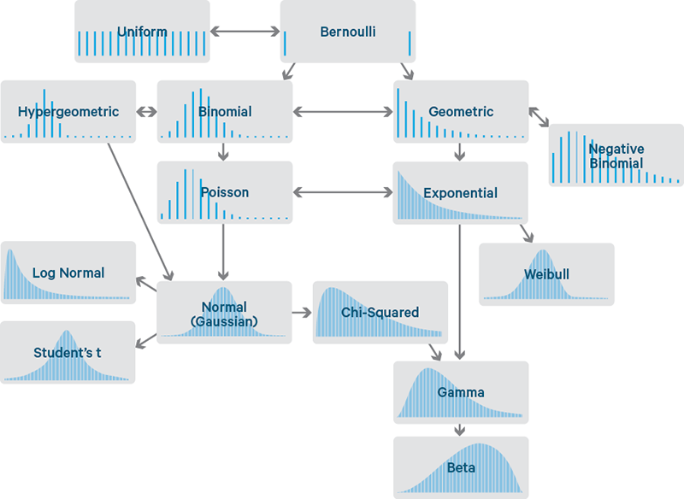
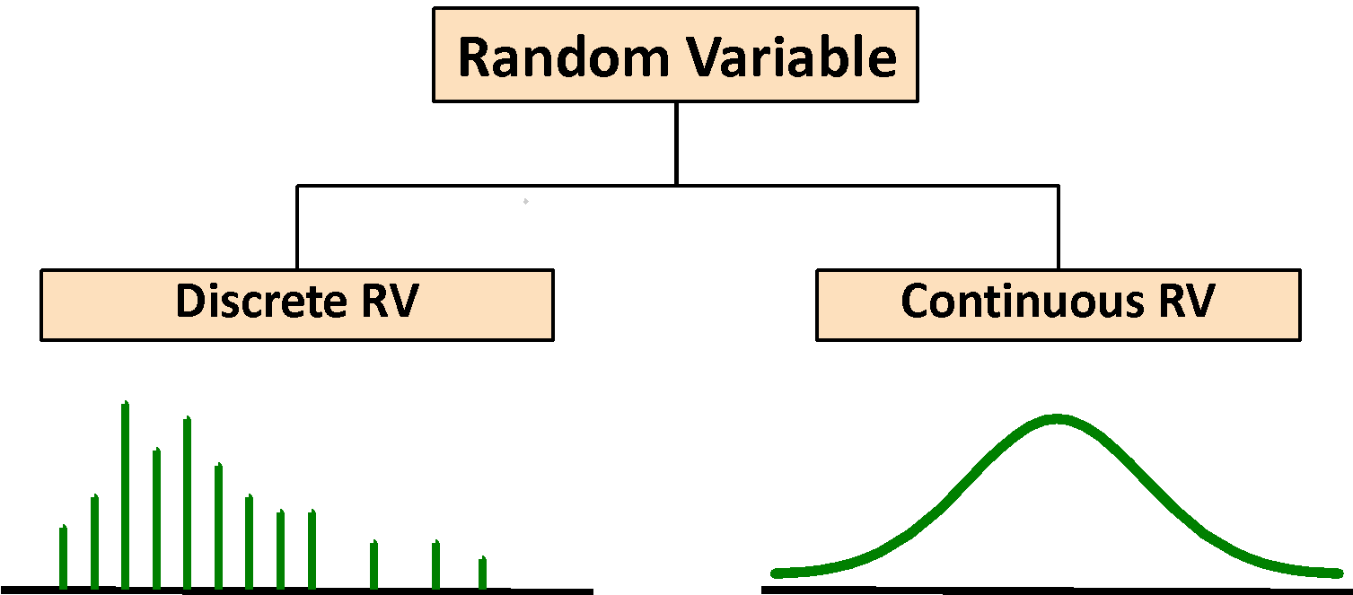
Recap: Random Variables
FIT-CS
INT3405 - Machine Learning

Slide 4

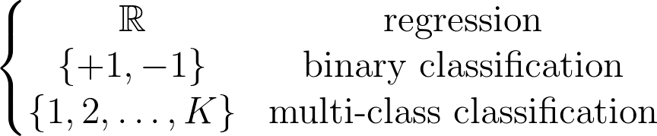






Supervised Learning
Supervised (Inductive) Learning
Formalization
Input:
Output:
Target function:
Training Data:
Hypothesis:
Hypothesis space:
(unknown)
FIT-CS
INT3405 - Machine Learning

Slide 5


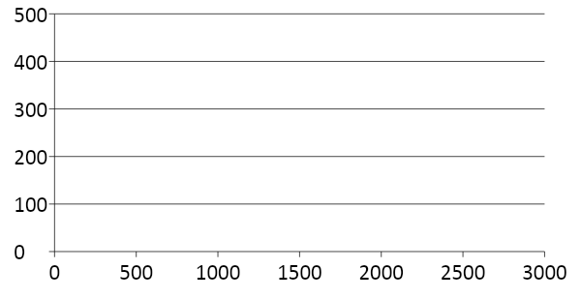
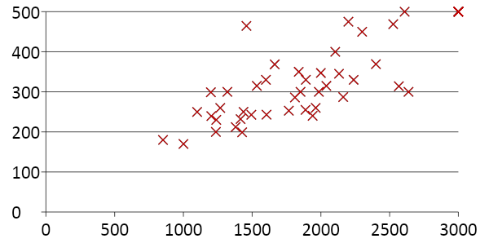
A Learning Problem
Unknown
Function
Input
Output
FIT-CS
INT3405 - Machine Learning

Slide 6
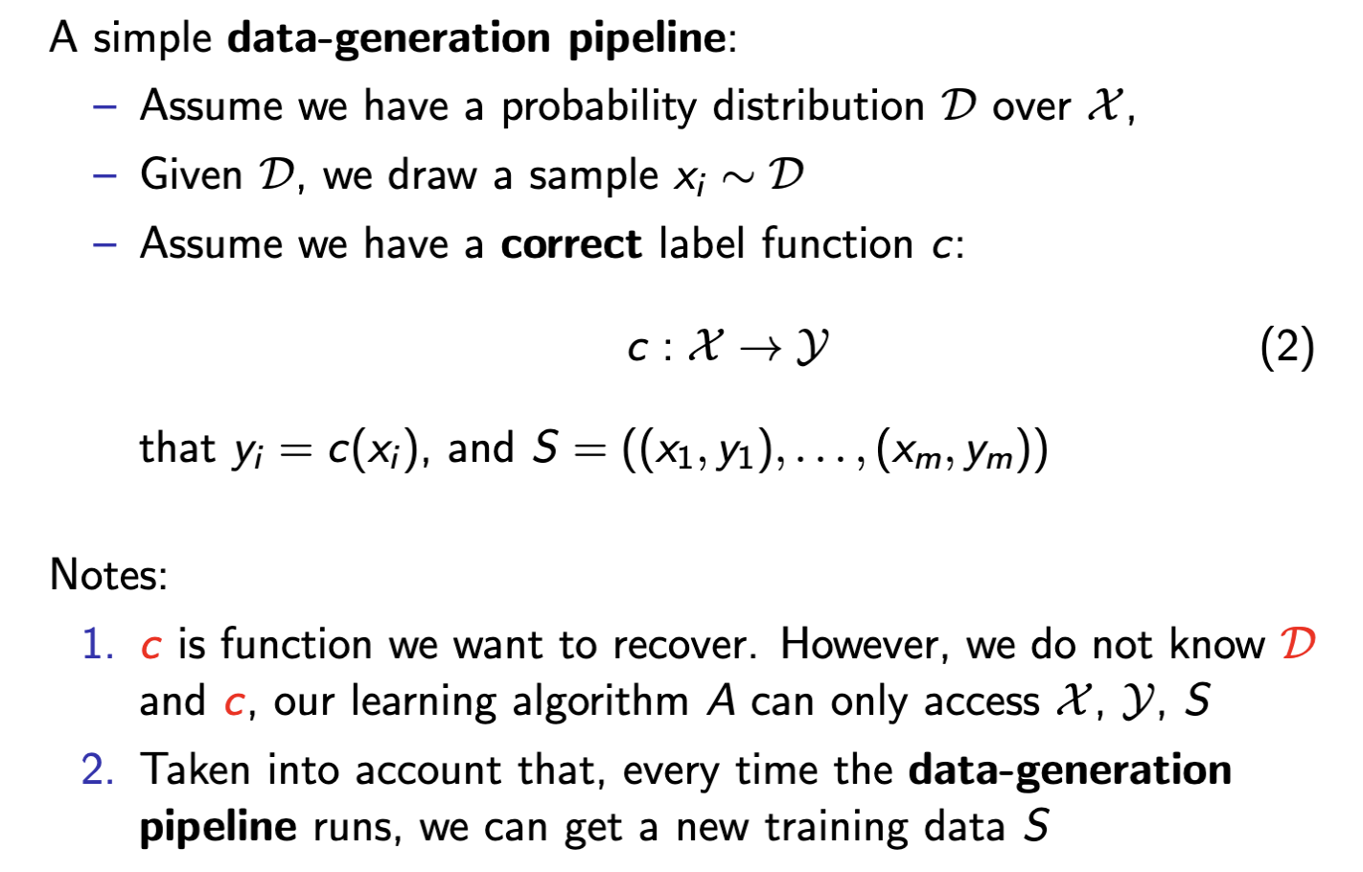
The Statistical Learning Framework

Slide 7
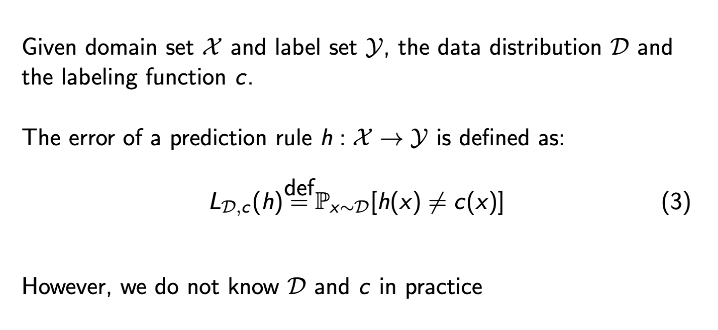
The Statistical Learning Framework

Slide 8
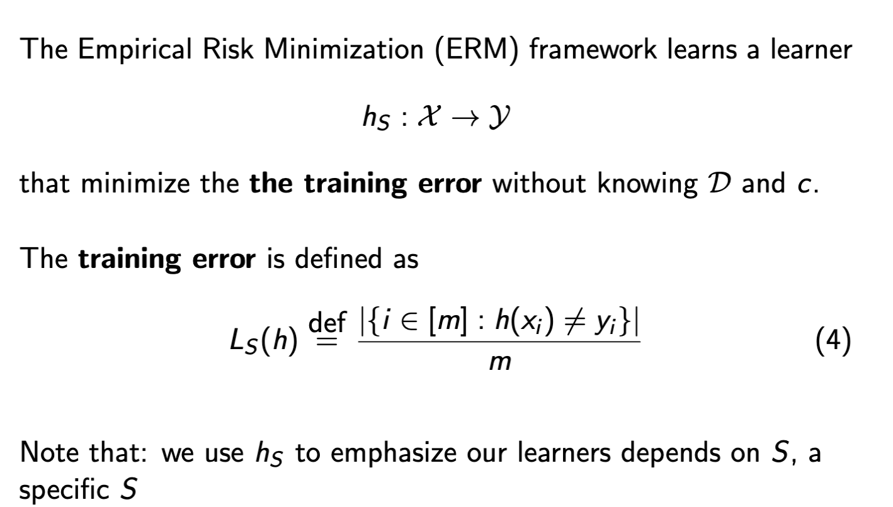
The Statistical Learning Framework

Slide 9


Hypothesis Spaces
Linear models
Infinite possible hypotheses!
Any choices of coefficient a and b will result in a possible hypothesis
Polynomial models
Any nonlinear models
FIT-CS
INT3405 - Machine Learning

Slide 10
Two Views of Learning
Learning is the removal of our remaining uncertainty.
If we are know that x and y are linearly dependent, then we could use the training data to infer the linear function
Learning requires guessing a good, small hypothesis class.
We could start with a very small / simple class, and enlarge it until it contains a hypothesis that fits the data
But we could be wrong
Our prior knowledge might be wrong
Our guess of the hypothesis class could be wrong
The smaller the hypothesis class, the more likely we are wrong
FIT-CS
INT3405 - Machine Learning

Slide 11
Two Strategies for Machine Learning
Develop Languages for Expressing Prior Knowledge
Rule grammars and stochastic models
Develop Flexible Hypothesis Spaces
Nested collections of hypotheses, rules, linear models, decision trees, neural networks, etc.
For either case, the key is to
Developing efficient algorithms for finding a Hypothesis that best approximates the target function for fitting the data
FIT-CS
INT3405 - Machine Learning

Slide 12
Key Issues in Machine Learning
What are good hypothesis spaces?
Which spaces have been useful in practical applications and why?
What algorithms can work with these spaces?
Are there general design principles for machine learning algorithms?
How can we find the best hypothesis in an efficient way?
How to find the optimal solution efficiently (“optimization” question)
How can we optimize accuracy on future data?
Known as the “overfitting” problem (i.e., “generalization” theory)
How can we have confidence in the results?
How much training data is required to find accurate hypothesis? (“statistical” question)
Are some learning problems computationally intractable? (“computational” question)
How can we formulate application problems as machine learning problems? (“engineering” question)
FIT-CS
INT3405 - Machine Learning

Slide 13
Regression with One Variable (1)
Housing Prices
(Portland, OR)
Price
(in 1000s of dollars)
Size (feet²)
Supervised Learning
Given the “right answer” for each example in the data.
Regression Problem
Predict real-valued output
FIT-CS
INT3405 - Machine Learning

Slide 14
Regression with One Variable (2)
Training set of
housing prices
(Portland, OR)
Size in feet² (x) | Price ($) in 1000's (y)
2104 | 460
1416 | 232
1534 | 315
852 | 178
… | …
Notation:
m = Number of training examples
x’s = “input” variable / features
y’s = “output” variable / “target” variable
FIT-CS
INT3405 - Machine Learning

Slide 15


Model Representation
Training Set
How do we represent h ?
Learning Algorithm
y
Size of house
h
Estimated price
x
x
Hypothesis
y
Linear regression with one variable.
“Univariate Linear Regression”
How to choose parameters ?
FIT-CS
INT3405 - Machine Learning

Slide 16

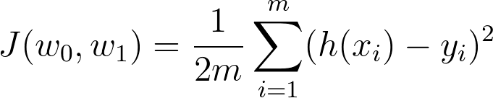

Formulation: Cost Function (1)
Hypothesis:
Parameters:
y
Cost Function:
mean squared error (MSE)
x
Goal:
FIT-CS
INT3405 - Machine Learning

Slide 17

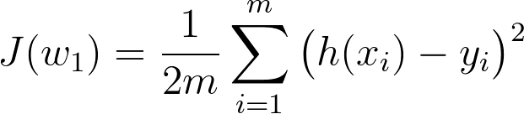

Formulation: Cost Function (2)
Simplified
Hypothesis:
Parameters:
Cost Function:
Goal:
FIT-CS
INT3405 - Machine Learning

Slide 18


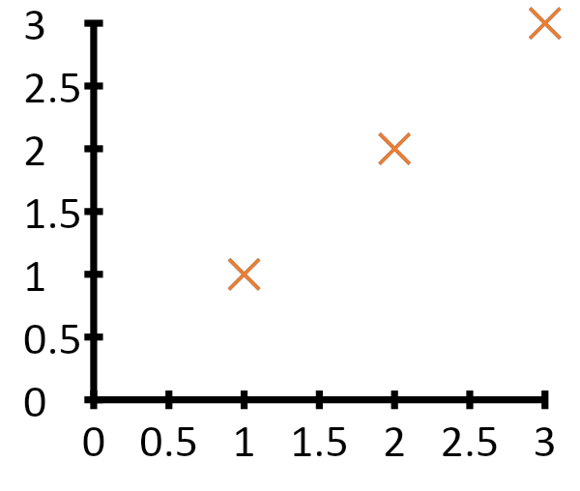
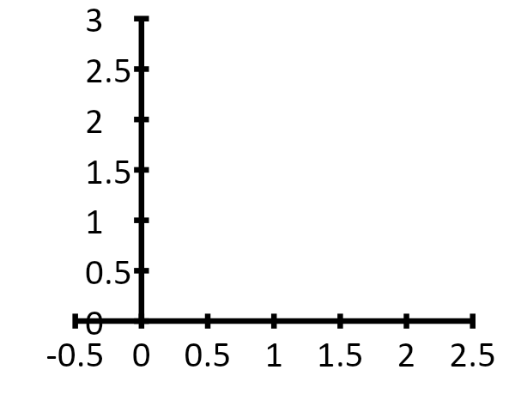


Cost Function: Example (1)
For fix this is a function of x function of the parameter
y
x
FIT-CS
INT3405 - Machine Learning

Slide 19

Cost Function: Example (2)
For fix this is a function of x function of the parameter
y
x
FIT-CS
INT3405 - Machine Learning

Slide 20

Cost Function: Example (3)
For fix this is a function of x function of the parameter
y
x
FIT-CS
INT3405 - Machine Learning

Slide 21


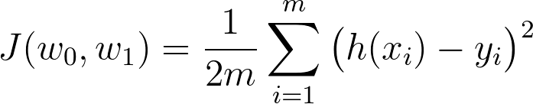
Cost Function (1)
Hypothesis:
Parameters:
Cost Function:
Goal:
FIT-CS
INT3405 - Machine Learning

Slide 22

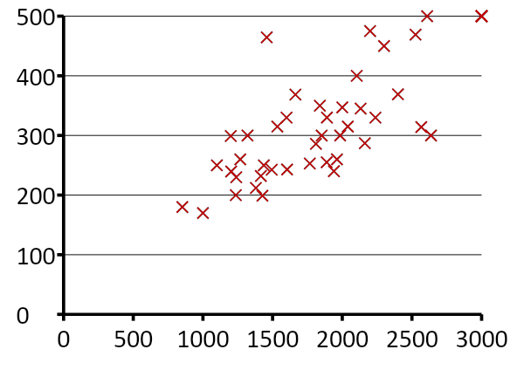
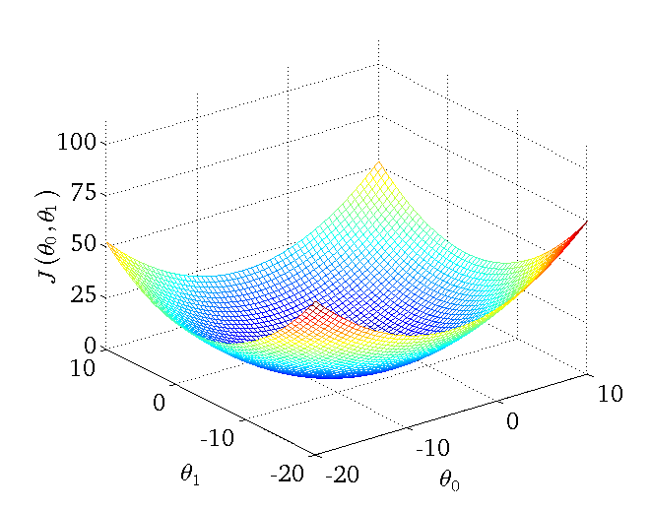

Cost Function (2)
(for fixed , this is a function of x)
(function of the parameters )
Price ($)
in 1000’s
Size in feet² (x)
FIT-CS
INT3405 - Machine Learning

Slide 23
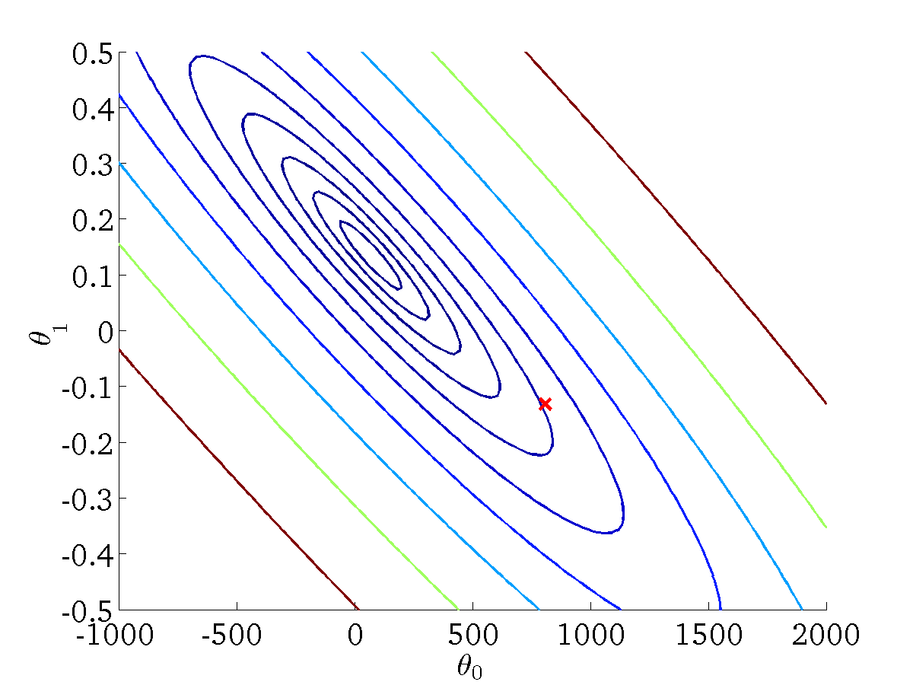
Cost Function (3)
Contour plots
FIT-CS
INT3405 - Machine Learning

Slide 24
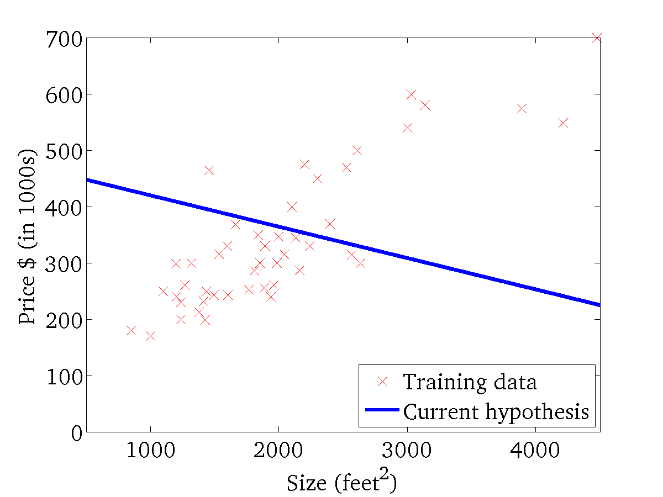
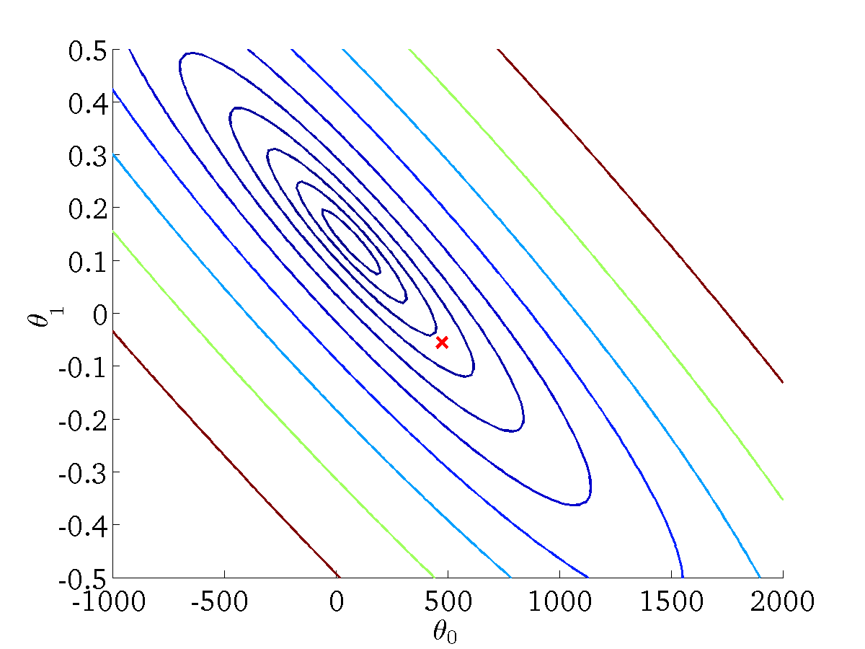
Cost Function (4)
(for fixed , this is a function of x)
(function of the parameters )
FIT-CS
INT3405 - Machine Learning

Slide 25
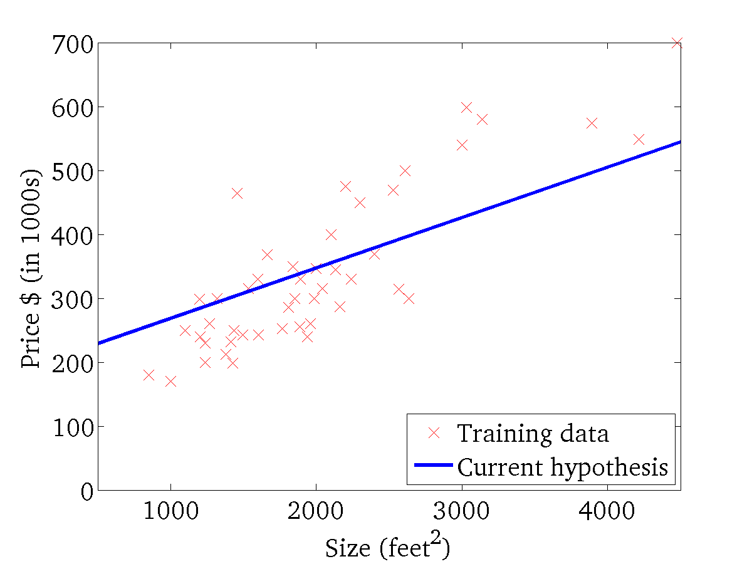
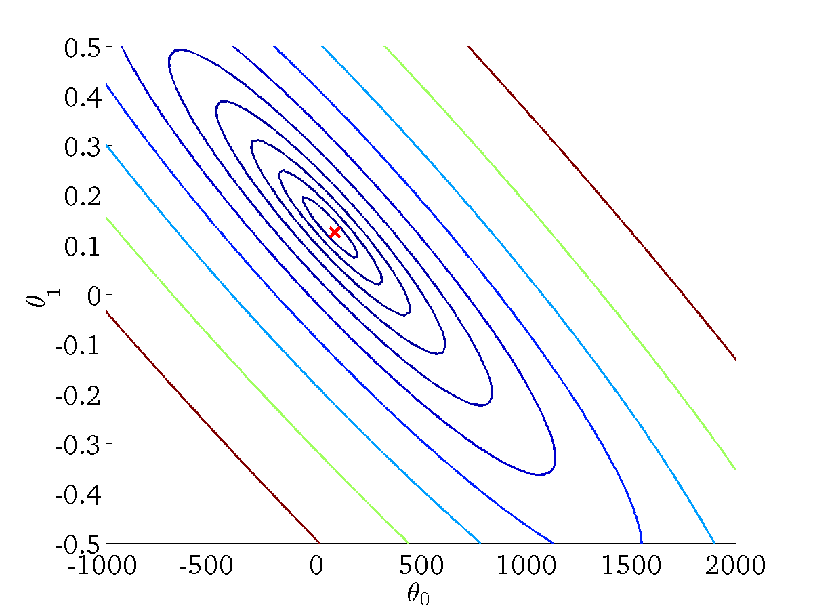
Cost Function (5)
(for fixed , this is a function of x)
(function of the parameters )
FIT-CS
INT3405 - Machine Learning

Slide 26

Gradient Descent for Optimization (1)
Given some objective function
Want to optimize
Outline:
Start with some
Keep changing to reduce until we hopefully end up at a minimum
FIT-CS
INT3405 - Machine Learning

Slide 27
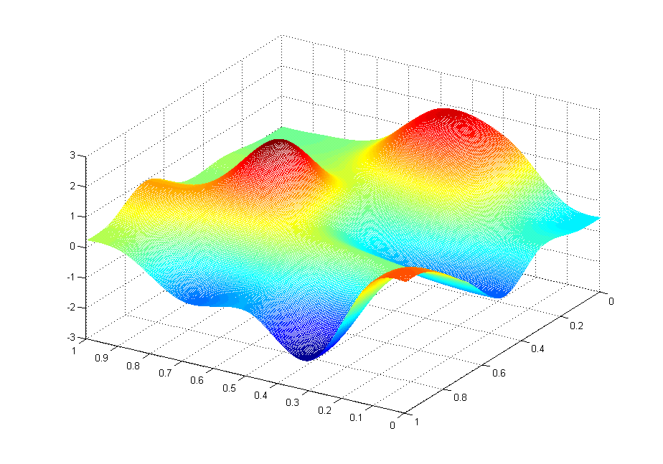
Gradient Descent for Optimization (2)
FIT-CS
INT3405 - Machine Learning

Slide 28
Gradient Descent for Optimization (3)
FIT-CS
INT3405 - Machine Learning

Slide 29
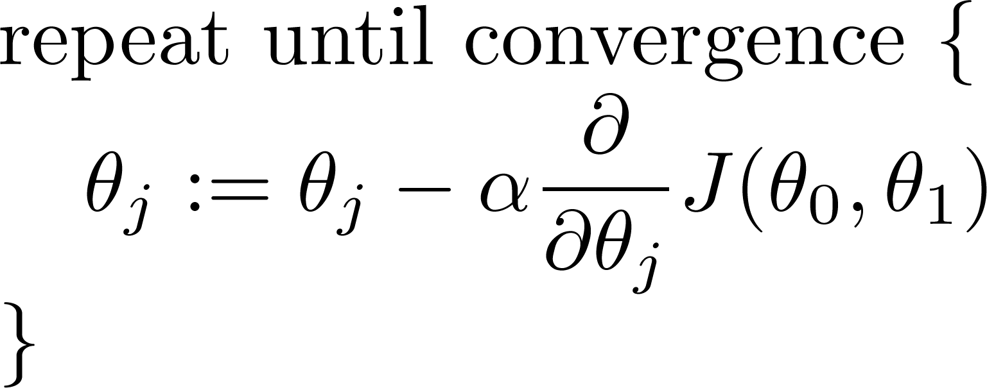
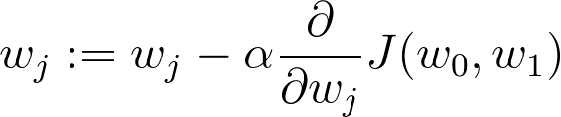
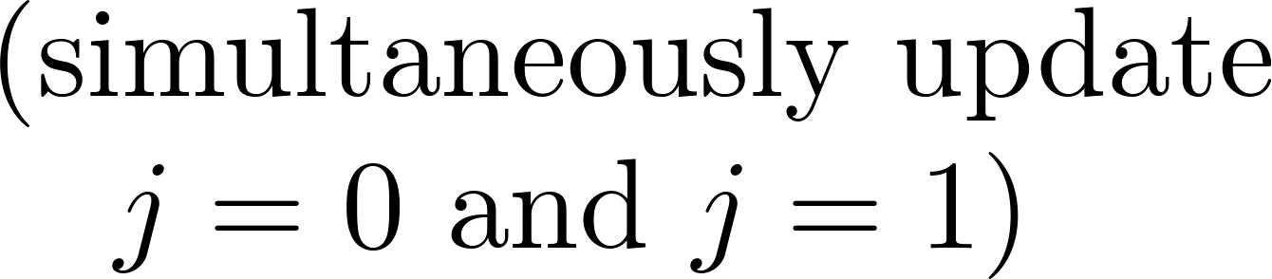
Gradient Descent Algorithm
Gradient descent algorithm
learning rate parameter
(rule of thumb: 0.1)
FIT-CS
INT3405 - Machine Learning

Slide 30
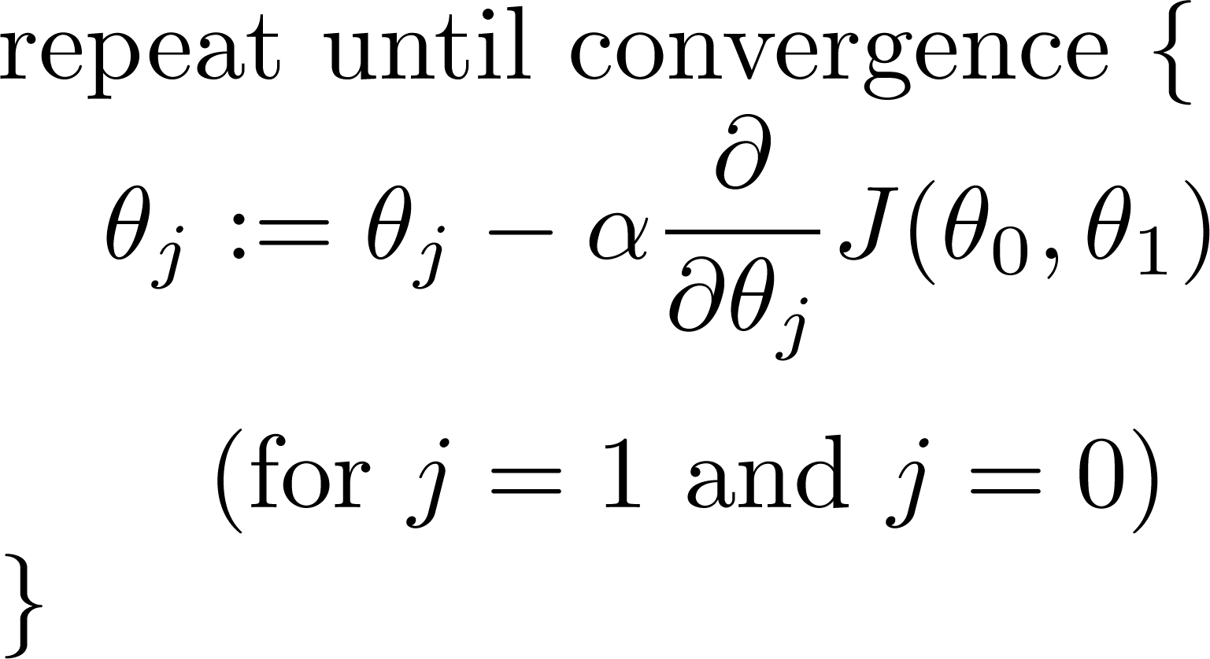
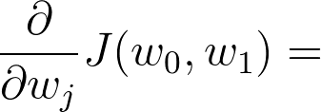
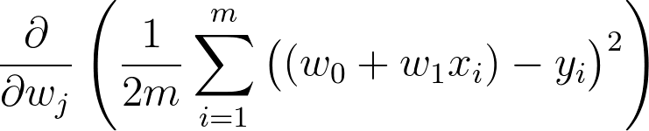
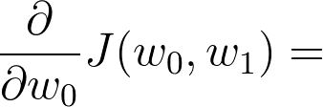
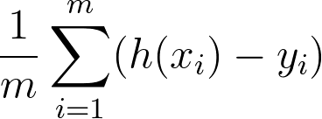
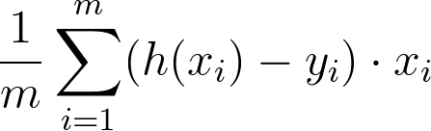
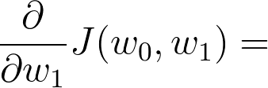
Gradient Descent for Linear Regression (1)
Gradient descent algorithm
Linear Regression Model
FIT-CS
INT3405 - Machine Learning

Slide 31
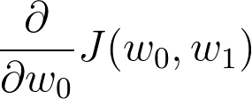
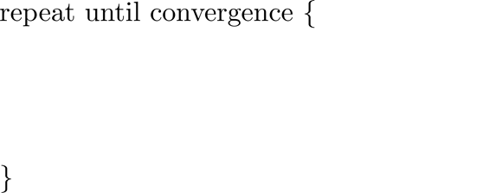
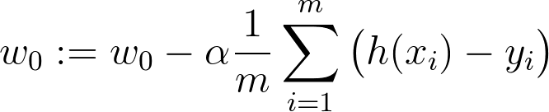
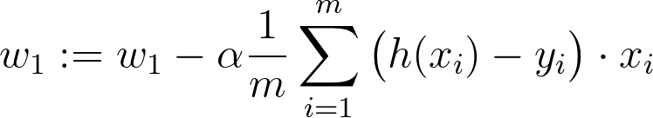
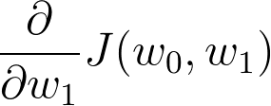
Gradient Descent for Linear Regression (2)
Gradient descent algorithm
update
and
simultaneously
FIT-CS
INT3405 - Machine Learning

Slide 32
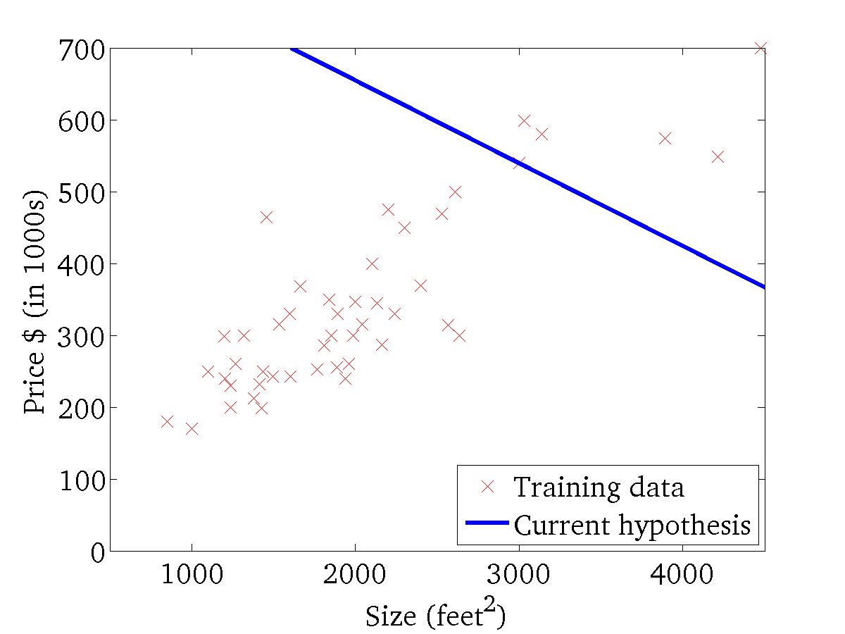
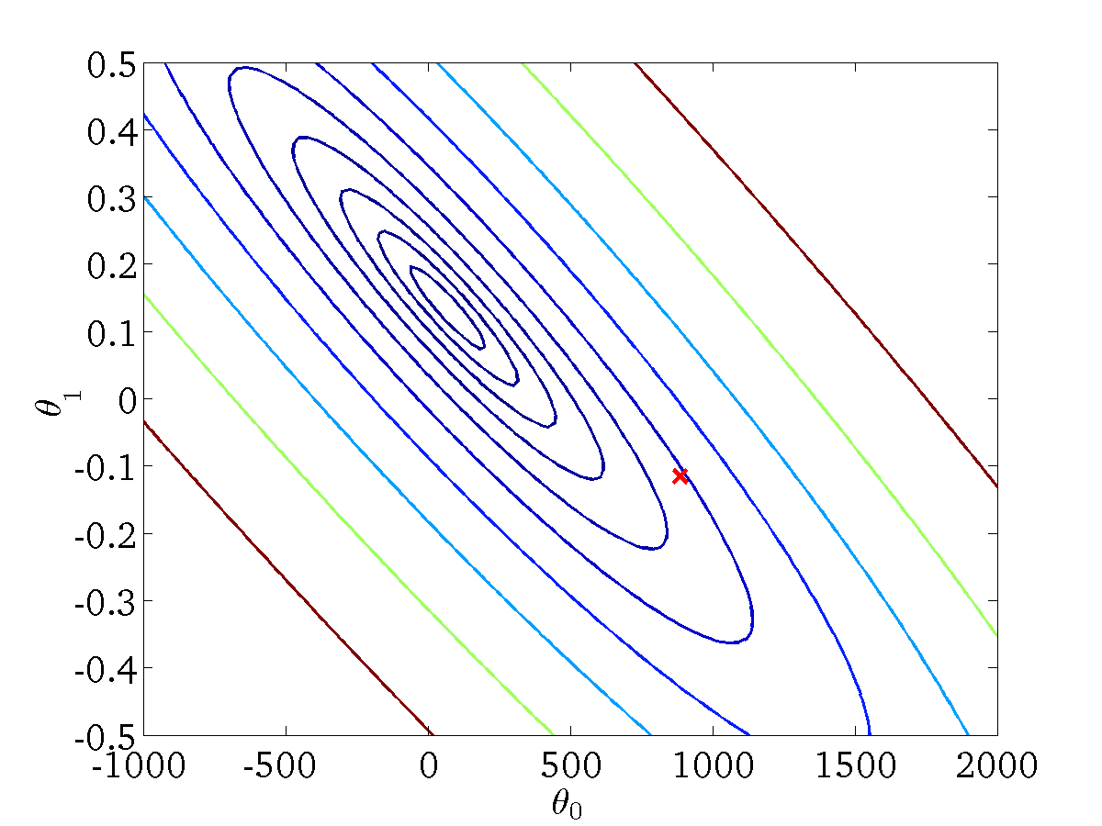
Gradient Descent Example (1)
(for fixed , this is a function of x)
(function of the parameters )
FIT-CS
INT3405 - Machine Learning

Slide 33
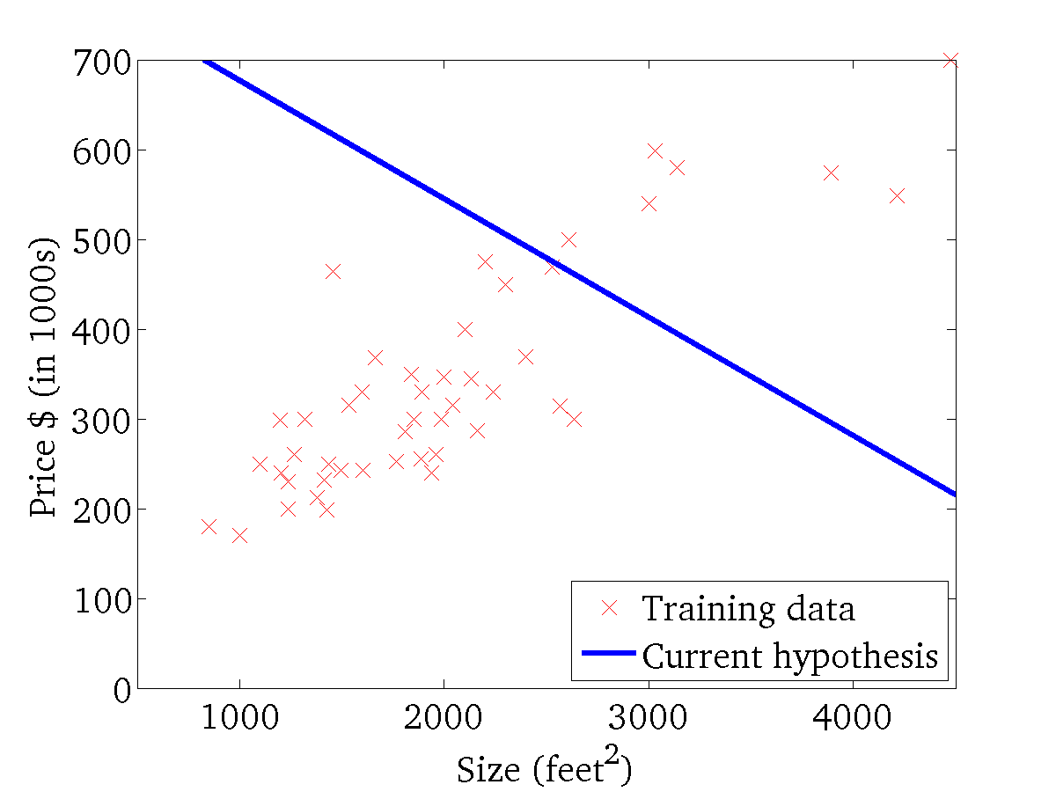

Gradient Descent Example (2)
(for fixed , this is a function of x)
(function of the parameters )
FIT-CS
INT3405 - Machine Learning

Slide 34
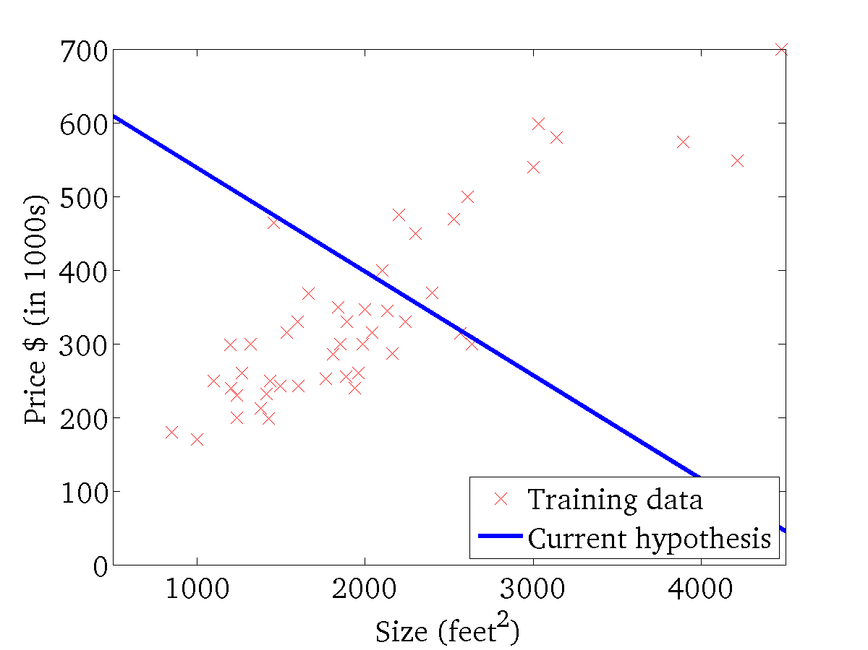
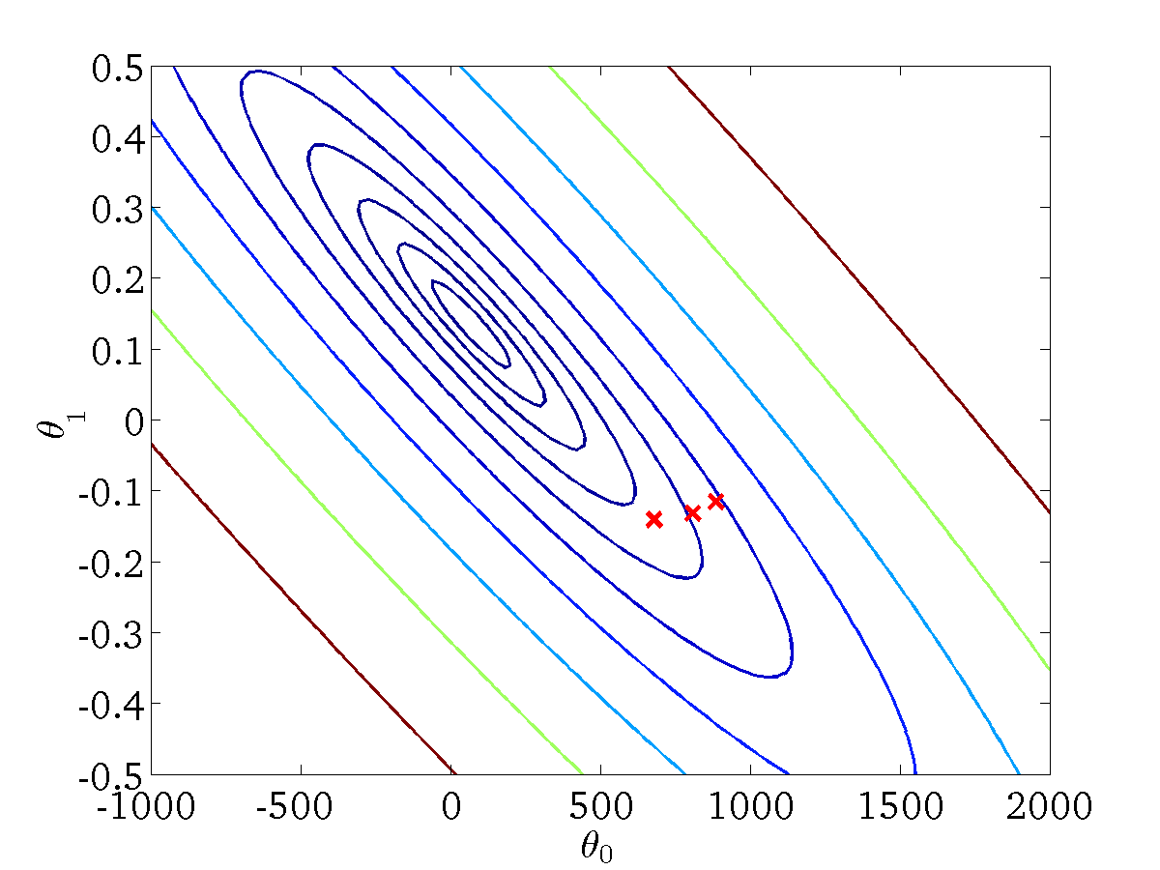
Gradient Descent Example (3)
(for fixed , this is a function of x)
(function of the parameters )
FIT-CS
INT3405 - Machine Learning

Slide 35
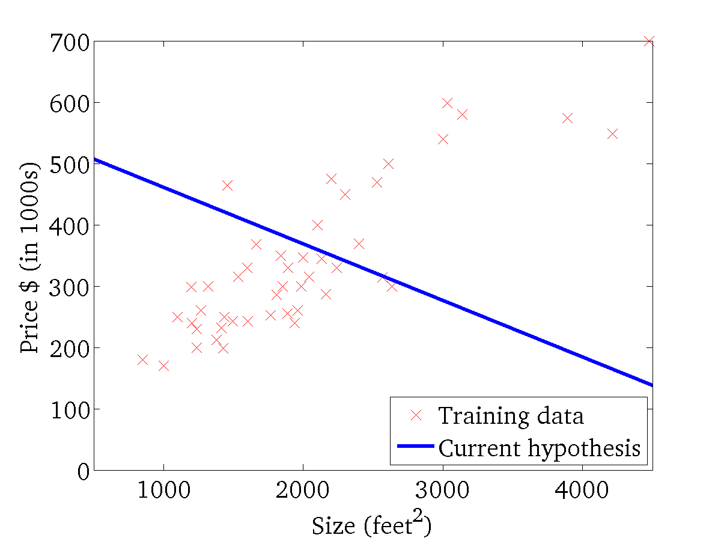

Gradient Descent Example (4)
(for fixed , this is a function of x)
(function of the parameters )
FIT-CS
INT3405 - Machine Learning

Slide 36
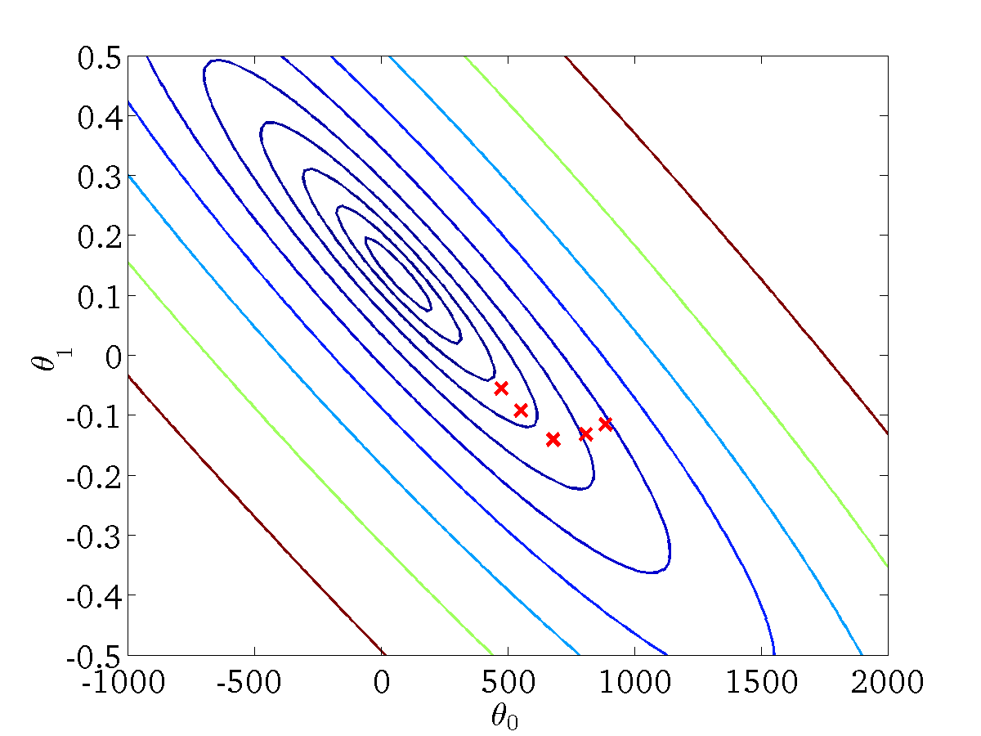
Gradient Descent Example (5)
(for fixed , this is a function of x)
(function of the parameters )
FIT-CS
INT3405 - Machine Learning

Slide 37
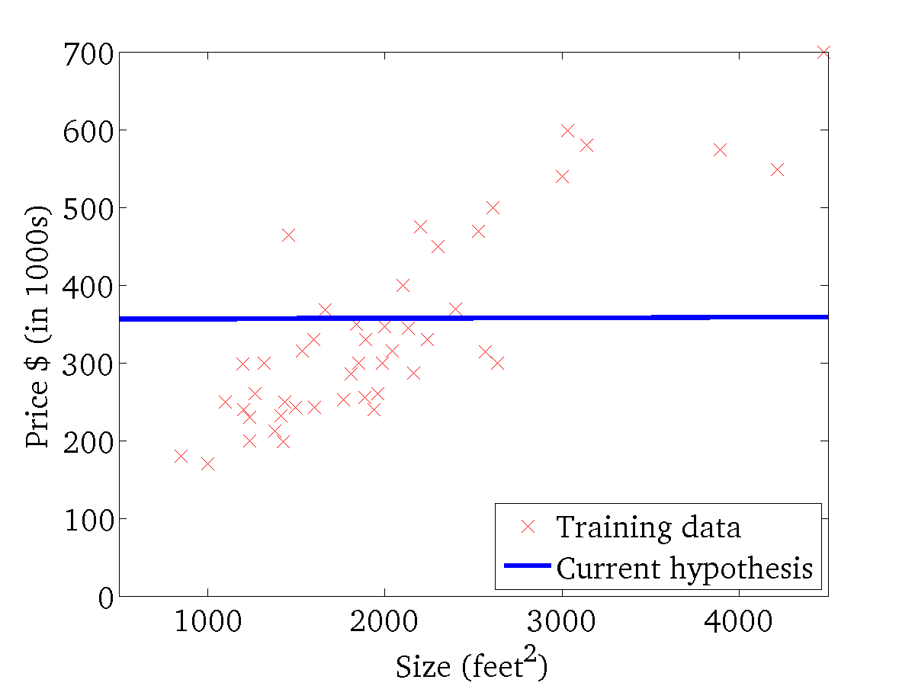

Gradient Descent Example (6)
(for fixed , this is a function of x)
(function of the parameters )
FIT-CS
INT3405 - Machine Learning

Slide 38
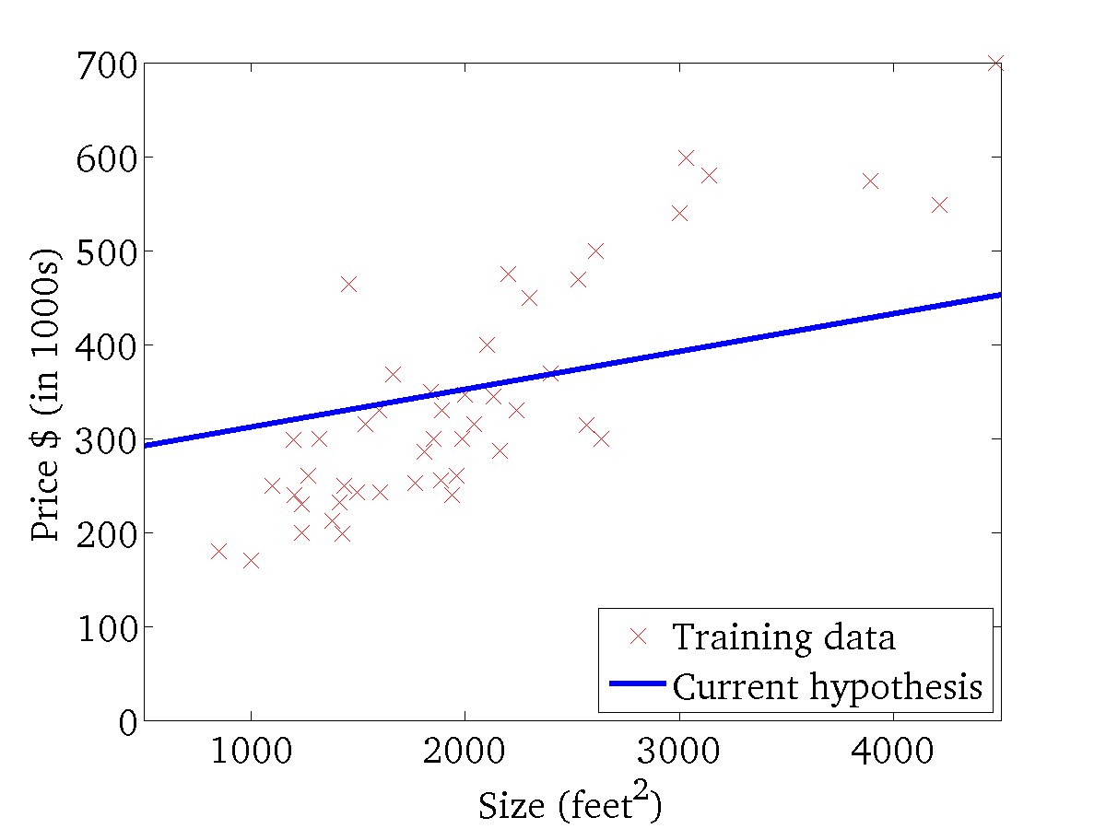

Gradient Descent Example (7)
(for fixed , this is a function of x)
(function of the parameters )
FIT-CS
INT3405 - Machine Learning

Slide 39
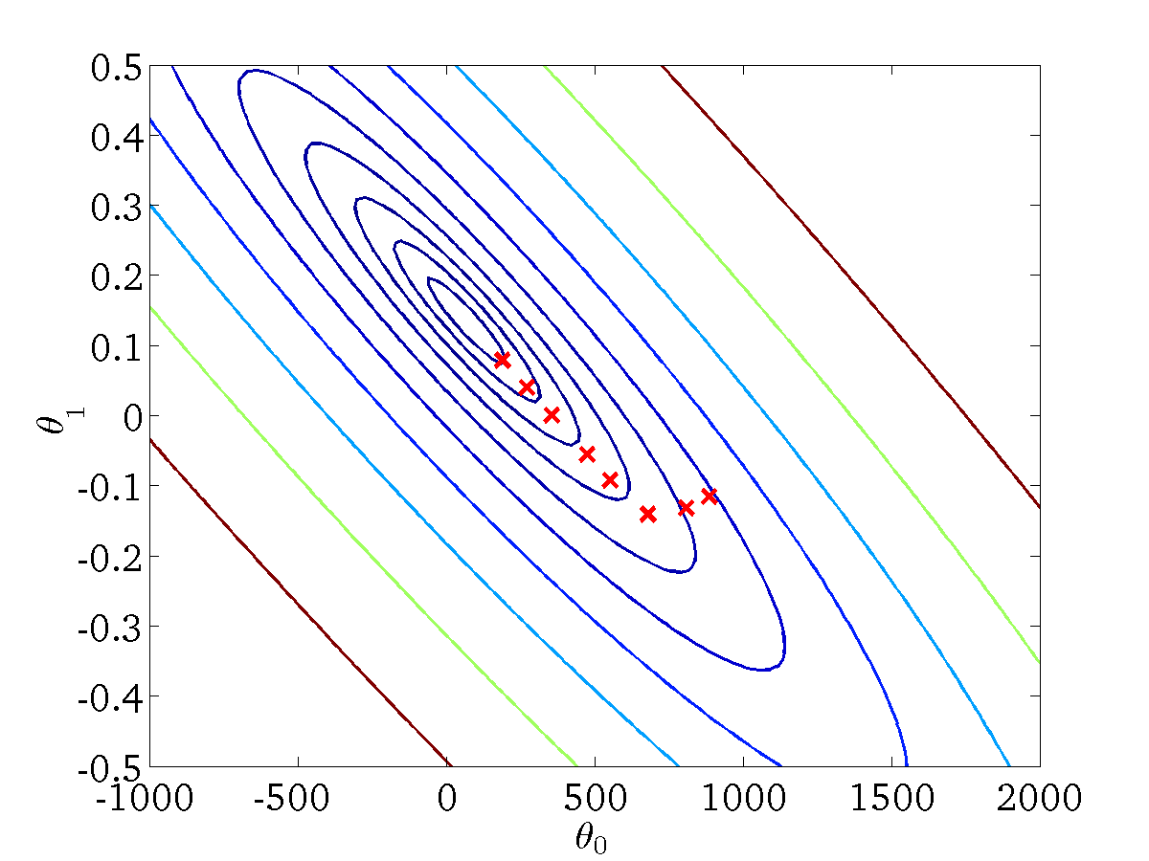
Gradient Descent Example (8)
(for fixed , this is a function of x)
(function of the parameters )
FIT-CS
INT3405 - Machine Learning

Slide 40
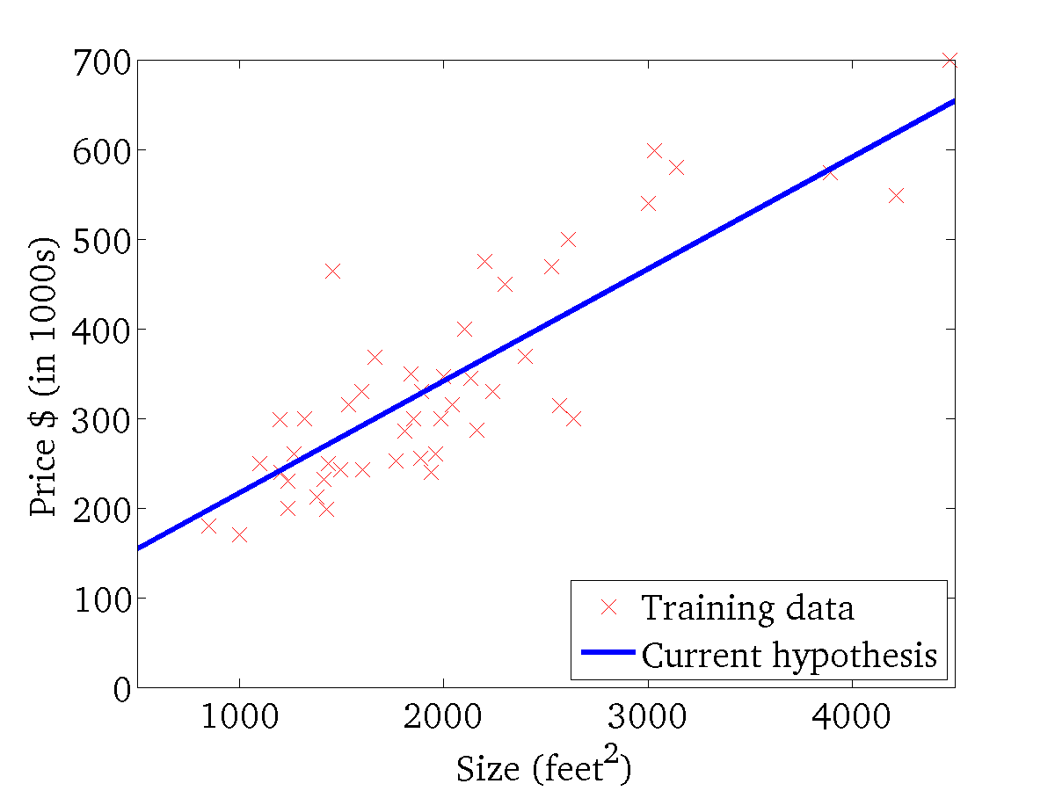

Gradient Descent Example (9)
(for fixed , this is a function of x)
(function of the parameters )
FIT-CS
INT3405 - Machine Learning

Slide 41
Batch Gradient Descent
“Batch”: Each step of gradient descent uses all the training examples.
FIT-CS
INT3405 - Machine Learning

Slide 42



Multivariate Linear Regression (1)
Multiple features (variables).
Size (feet²) | Number of bedrooms | Number of floors | Age of home (years) | Price ($1000)
2104 | 5 | 1 | 45 | 460
1416 | 3 | 2 | 40 | 232
1534 | 3 | 2 | 30 | 315
852 | 2 | 1 | 36 | 178
… | … | … | … | …
Notation:
= number of features
= input (features) of training example.
= value of feature in training example.
FIT-CS
INT3405 - Machine Learning

Slide 43

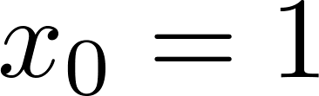
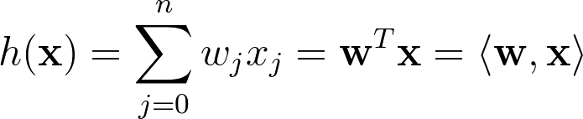


Multivariate Linear Regression (2)
Hypothesis:
Previously:
For convenience of notation, define .
FIT-CS
INT3405 - Machine Learning

Slide 44


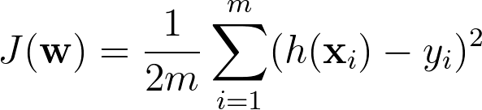






Gradient Descent for Multivariate LR
Hypothesis:
Parameters:
Cost function:
Gradient descent:
Repeat
(simultaneously update for every )
FIT-CS
INT3405 - Machine Learning

Slide 45




Univariate LR vs Multivariate LR
Gradient Descent
Previously (n=1):
New algorithm :
Repeat
Repeat
(simultaneously update )
FIT-CS
INT3405 - Machine Learning

Slide 46





Convergence and Learning Rate
Example automatic convergence test:
Declare convergence if decreases by less than in one iteration.
No. of iterations
For sufficiently small , should decrease on every iteration.
But if is too small, gradient descent can be slow to converge.
If is too large: may not decrease on every iteration; may not converge.
FIT-CS
INT3405 - Machine Learning
SML– Term 1 2020-2021

Slide 47


Learning Rate
divergence
gradually decreased
too small constant
too large
FIT-CS
INT3405 - Machine Learning

Slide 48



Normal Equation (1)
Gradient Descent
Iterative approach
Normal Equation
Analytical method to solve
Intuition Example: If 1D
Solve equation to find w
FIT-CS
INT3405 - Machine Learning

Slide 49






Normal Equation (2)
FIT-CS
INT3405 - Machine Learning

Slide 50






Normal Equation (3)
Matrix-vector formulation
Analytical solution
FIT-CS
INT3405 - Machine Learning

Slide 51





The Pseudo-inverse
FIT-CS
INT3405 - Machine Learning

Slide 52










Normal Equation: Example
Examples:
 | Size (feet²) | Number of bedrooms | Number of floors | Age of home (years) | Price ($1000)
1 | 2104 | 5 | 1 | 45 | 460
1 | 1416 | 3 | 2 | 40 | 232
1 | 1534 | 3 | 2 | 30 | 315
1 | 852 | 2 | 1 | 36 | 178
Size (feet²) | Number of bedrooms | Number of floors | Age of home (years) | Price ($1000)
2104 | 5 | 1 | 45 | 460
1416 | 3 | 2 | 40 | 232
1534 | 3 | 2 | 30 | 315
852 | 2 | 1 | 36 | 178
is inverse of matrix .
FIT-CS
INT3405 - Machine Learning

Slide 53


Gradient Descent vs Normal Equation
training examples, features.
Gradient Descent
Normal Equation
Need to choose .
Needs many iterations.
No need to choose .
Don’t need to iterate.
Works well even when is large.
Need to compute
Slow if is very large.
FIT-CS
INT3405 - Machine Learning

Slide 54
Summary
Supervised Learning
Linear Regression with One Variable
Model Representation
Cost Functions
Gradient Descent
Linear Regression with Multiple Variables
Learning rate
Normal Equation
Duc-Trong Le
FIT-CS
INT3405 - Machine Learning
INT3405 - Machine Learning

Slide 55
Excercises
Rewrite the Gradient Descent approach and Analytical solution for the Lasso Regression in details (using L1 in the J(w)). Explain what happen when 𝛌 -> Infinity
For computing the Analytic Solution, we need to compute the inverse matrix. Discuss how we can compute it in different cases of input data.
Duc-Trong Le
FIT-CS
INT3405 - Machine Learning
INT3405 - Machine Learning

